Slide 1
Family Planning Services in Sri Lanka
Manuja Perera
04.06.2018

Slide 2
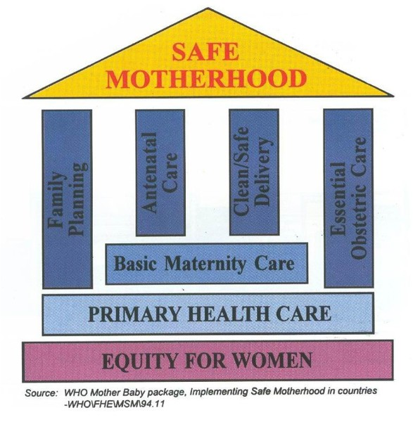

Slide 3
Contraceptive Methods
Modern Methods
Permanent Methods
(Sterilization)
Temporary Methods
(barrier methods/ hormonal methods)
Traditional Methods
Fertility Awareness Based Methods (Symptoms based/Calendar based)
Withdrawal, Lactational Amenorrhea

Slide 4
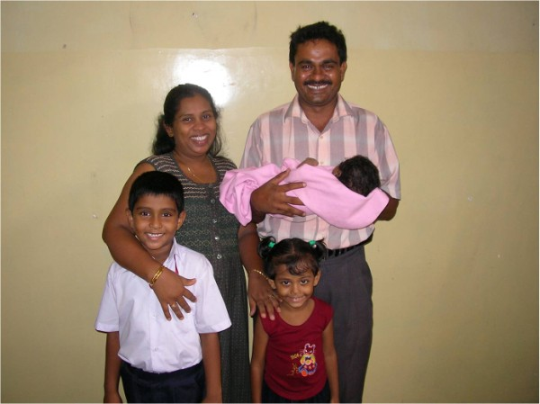
Family Planning Unit of Family Health Bureau
Focal point for the National Family Planning Programme
Responsible for national level policy and guideline formulation
Goal
Enable all couples to have a desired number of children with optimal spacing whilst preventing unintended pregnancies
4

Slide 5
Objectives
Prevent unintended Pregnancies
Includes;
Delaying the 1st pregnancy to prevent teenage pregnancies
Promoting optimal birth spacing intervals (OBSI)
Preventing unwanted pregnancies (limiting the number)
Help sub fertile couples to conceive

Slide 6
National Family Planning Programme
Family Health Bureau/MoH
Field Health Services
Field FP clinic
Domiciliary care
Curative health Services
FP clinic
Sterilization services

Slide 7
Modern Family Planning Methods Available in the National Programme
Permanent methods
Female and Male sterilization
Temporary methods
Barrier methods
Male condoms
Hormonal methods
OCP (COCP)
Injections (DMPA)
Implants (Levonogestrel - Jadelle™)
Intra Uterine Devices
Cu-IUD
Read
Eligibility
Contraindications
Success rates
Side effects
Advise for users
Will be discussed in the PBL sessions

Slide 8
Family Planning (FP) Services in Sri Lanka
Field health services
Recruitment of eligible couples
Provision of services
FP clinics – Condoms, COCP, Injectable, Implants, IUCD, Referral for permanent methods, Emergency contraceptive methods
PHM – Condoms, COCP
PHI - Condoms
Follow up

Slide 9
Eligibility to obtain services from the National FP Programme

Slide 10
Eligible Family
A - A couple in union (married legally, customary or living together) having a female aged 15-49yrs of age (Eligible couple)
Also when there is
B - an unmarried pregnant female of any age
C - a child less than 5 years of age
D – a couple in union even if the female's age is less then 15 years
E – female aged 15-49yrs who is widowed/ divorced/ separated

Slide 11
Eligibility to obtain a specific contraceptive method from the National FP Programme

Slide 12
Medical Eligibility Criteria for Contraceptive Use – WHO (5th Ed. 2015)

Slide 15
Eligibility for Sterilization General Circular No. 1586 - Office of the Director General of Health Services
Over 26 years of age,
having at least 2 living children, with the younger being over 2 years
having 3 or more living children
Under 26 years,
his/her spouse insist on a sterilization,
minimum of 3 living children
Medical Officer concerned could use his/her discretion, and perform the sterilization after personally checking the validity of information provided
Medical indications
should be referred to a specialist in the relevant field, who should make the final decision

Slide 17
Different Categories of Users in the National FP Programme
New acceptor
Current user
Unmet need

Slide 18
New Acceptor for the Programme
An individual accepting any FP method for the first time in life from the NFPP
New Acceptor for the Method
An individual accepting a FP method for the first time from the NFPP
Current User
An individual using a FP method at a given point of time

Slide 19
Unmet need for Contraception - Definition
A woman is having an unmet need for contraception if she is:
Fertile
Married or living in union
Not using any contraception (modern, natural or traditional)
Not wanting any more children or wanting to postpone for at least two years

Slide 20
Unmet need for Contraception – Check list
Whether a woman is currently:
1. Registered in the eligible families register yes no
2. At risk of getting pregnant yes no
3. Using any contraception (modern, natural or traditional) yes no
4. Hoping to have a child within the next 2 years yes no

Slide 21
National MIS in Family Planning Services
Registers
Eligible Family Register
Records
Family Planning Clinic Record
Family Planning Field Record
Family Planning Client Record
Returns
Family Planning Consolidated Return (H1159)
Family Planning Monthly Return (H1200)

Slide 22
New Acceptors
RECRUITED IN THE CLINIC
RECRUITED IN THE FIELD
Family Planning Clinic Record H 1153
Family Planning Field Record H 1154
Family Planning Client Record H 1155
Family Planning Client Record H 1155
Family Planning Monthly Return H 1200
PHM
Clinic/ Hospital
A
A
MOH Office
B
RDHS
FHB

Slide 23
FP – Current Users
PHM Monthly Statement H 524
FP Field record
FP Consolidated Return H 1159
Duplicate
RDHS Office

Slide 24
Indicators used to evaluate the National FPP
Contraceptive Prevalence Rate (CPR)
Prevalence of unmet need
Rate of teenage pregnancies
Crude Birth Rate (CBR)
Total Fertility Rate (TFR)
Rate of Natural Increase (CBR-CDR)
Growth Rate (NI+Nett Migration)
Septic abortion Rate

Slide 25
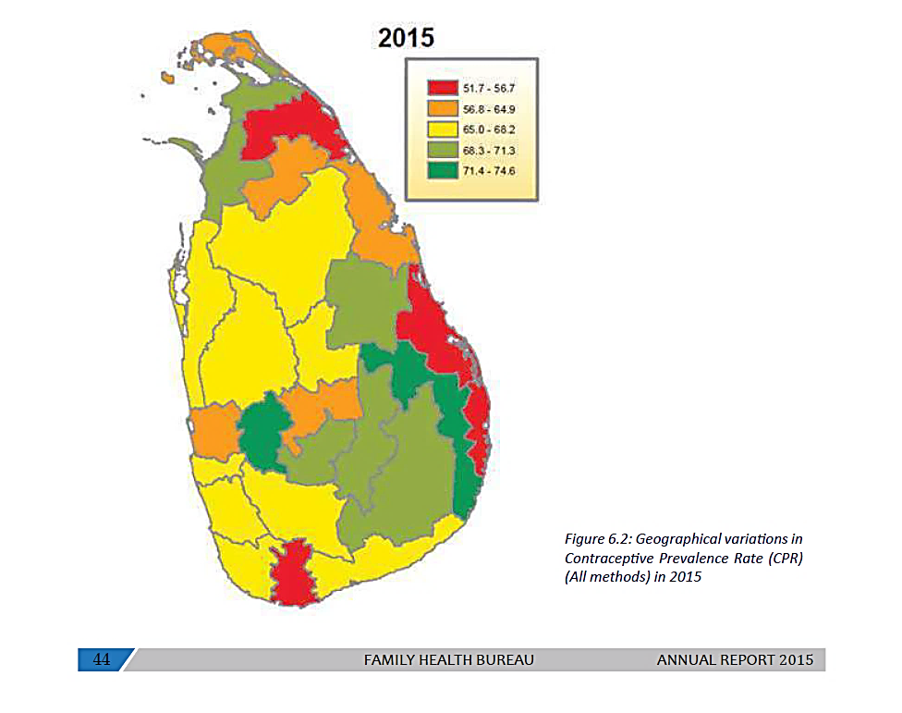

Slide 26
Source: Family Health Report 2013 (FHB)

Slide 27
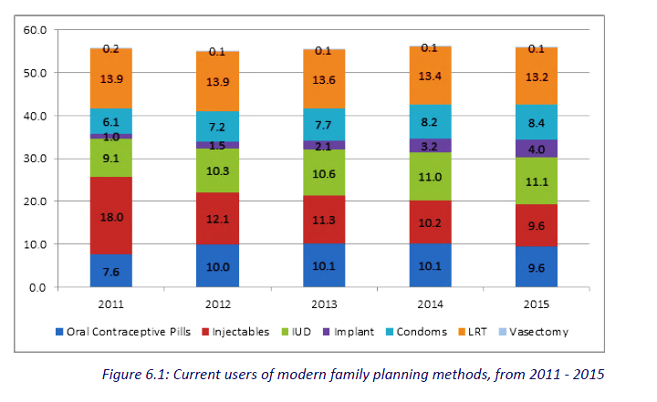

Slide 28
Issues in FP service delivery
1. FP Clinic services
Limited access
Limited availability of contraceptive methods
Counselling males
2. Sterilization services
Unmet demand
Poor accessibility/availability of services
3. Adults-unmarried sexually active
4. Inappropriate use of emergency contraceptives
5. Lack of post abortion care - Repeated abortions

Slide 29
Counselling in FP services
A crucial component of family planning services
An interactive systematic process to help the clients
to make informed decisions on their reproductive options including pregnancy and family planning
to select the appropriate family planning method voluntarily and
to use it more effectively
Should be an ongoing process
Should involve the spouse/partner whenever possible

Slide 30
Counselling in FP services – A practical model
G – Greet the client in a friendly and respectful manner
A – Ask about themselves
T – Tell and listen to clients. Depending on the clients’ needs, tell the clients what reproductive health choices are available to them
H – Help clients to make an informed choice
E – Explain all the details about the selected method
R – Return visits for routine follow up regarding complications, new developments and to clarify doubts

Slide 31
Counselling in FP services – What to explain?
What the method is
How it works
Safety
Effectiveness & duration
Contraindications
Side effects and complications
When to use
How to use
Who will provide the method
Where to obtain the method
When to return/follow up
How to stop the method
Reuse of the method
Return of fertility
Additional information (e.g. myths)

Slide 32
Thank You!

